Slide 1


All-In-One Planner
By
John Cheney And
Keri Gabriel

Slide 2


Your problem and proposed solution.
The problem that we had was having a place to store all our information in one place.
like a planner!!

Slide 3
How did you set about planning the project?
We used a Trello board with user statements and wireframes for our initial planning.
We continued to update the board throughout our project.

Slide 4
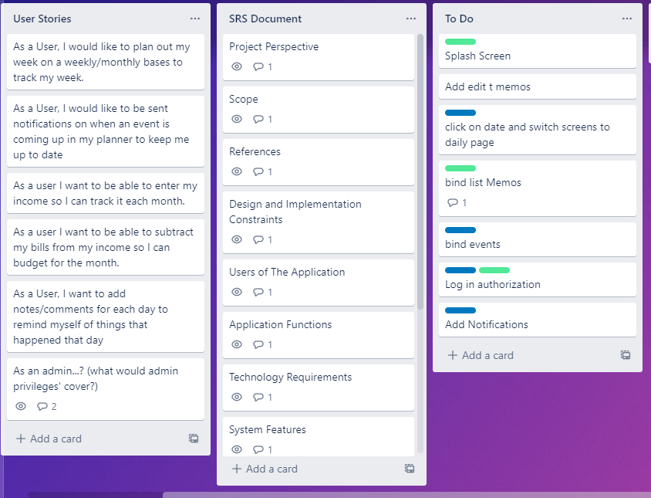

Slide 5
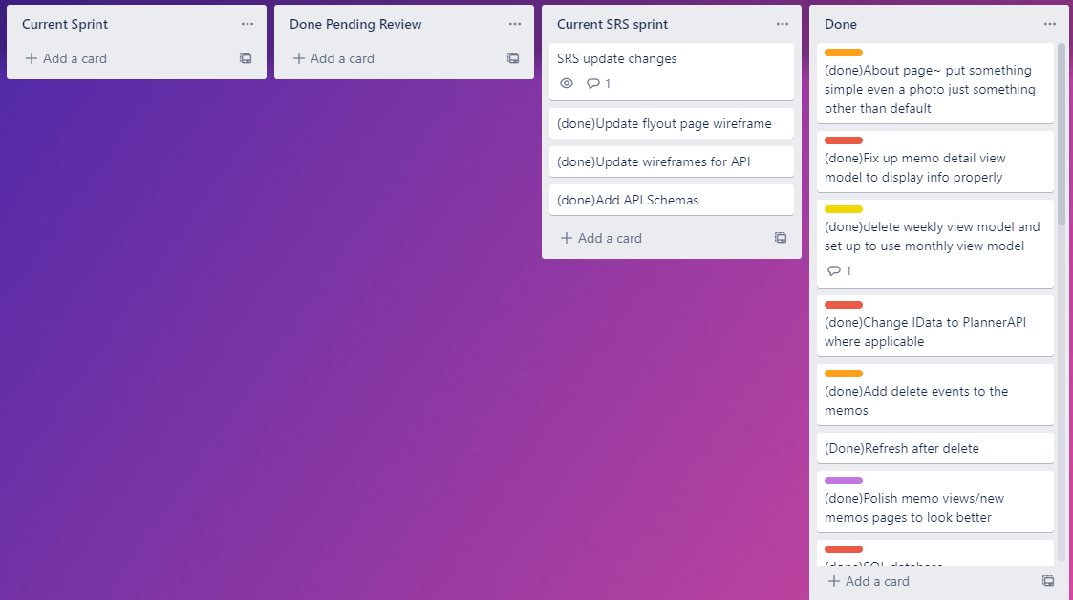

Slide 6
Main Feature
Memo features
Create and Delete
Connected to API database.
Add feature includes:
date
category
name
description

Slide 7
Additional features and their reasons for being included.
Memo View
To view all added memos
Weekly View
To view the calendar in weekly view
Monthly View
To view the calendar in a monthly view
Flyout menu
For navigation.
Login page
To log in and keep information secure, and the ability to log in on multiple devices.
About Page
For information about the app in future
Add Memos
To keep track of events or reminders
Memo Detail Page
Display details of memo

Slide 8
And here is our App

Slide 9
And here is our API

Slide 10
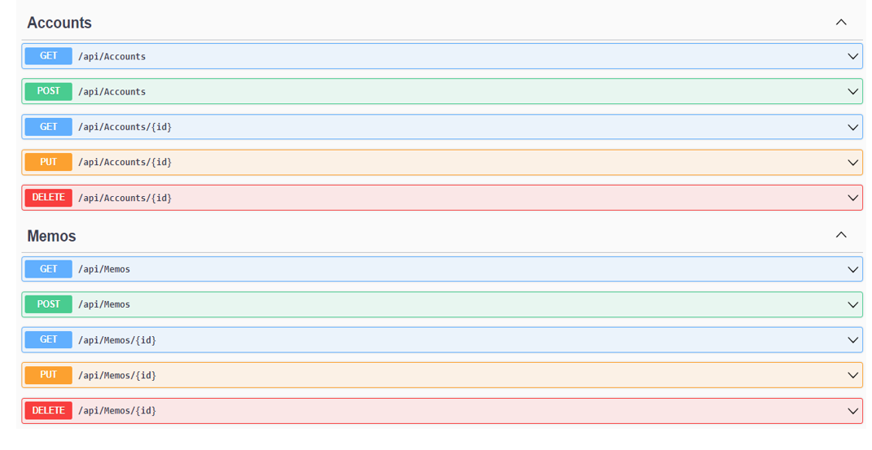
API CRUD with Swagger

Slide 11
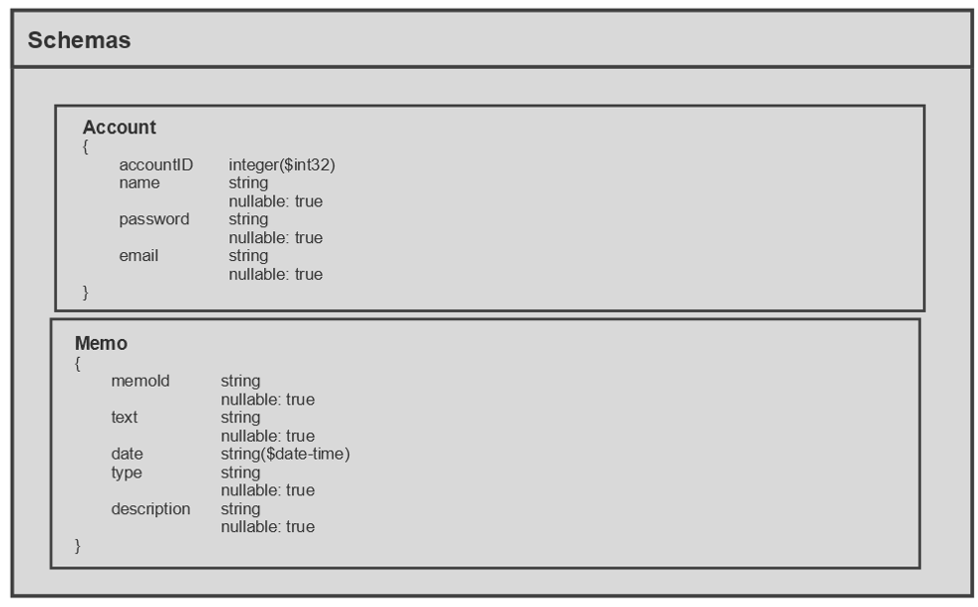
API Schemas

Slide 12
Technology choices made and why we made them.
We used Xamarin forms with MVC framework.
MVC is made up of 3 components:
model, the view, and the controller.
In Xamarin the controller is the ViewModel.
We chose to use Xamarin because we wanted to make an android application.
For our API we used ASP.NET Core Web API
We chose it because it was an easy setup and was all we needed.

Slide 13
How did your user testing go, and what changed because of it.
Our User testing went well. We had multiple People test our application.
Their complaints were:
Not having initial instructions
And the layout/color.
What we changed:
Color theme
Made the text larger for easier visual
The navigation titles; more relevant to their functionality.

Slide 14
Things that went well
We worked well together
We were able to schedule meeting times frequently
We communicated well on things that needed to be done.
The Trello board really helped in early planning.
Choice in technology
Xamarin was easy to figure out for us
it was similar to last quarter’s work
and there was lots of documentation.

Slide 15
Things you would have done differently
Set up the API in the very beginning.
That way we would have had more time, instead of having to set up the database base twice because at first, we were using a mock database.
Spending too much time trying to bind data to the calendar instead of focusing on polishing up other features that were already working.

Slide 16
Difficulties
Setting up routing for the API.
Since we were using an emulator and self-hosted API the routing was different and we struggled with it for a few weeks.
Binding memo data to the calendar by date.

Slide 17
Where would you like to take the project in the future?
Some features that we wanted to add were:
Binding memos to the calendar.
Security
User accounts connected to API.
Financial information and budgeting capability.
An initial instruction information page.

Slide 18
Any Questions???

